Slide 1
CURRENCY CONVERTER
-IN PYTHON

Slide 2
CONTENTS:-
Introduction​
Project Details
​Features
Flow Chart
GUI Design
Database Design
Base Code And Output
Conclusion

Slide 3
INTRODUCTION

Slide 4
MOTIVATION:-
The idea for the Currency Converter Application was inspired by the realization that, in our increasingly linked world, there is a worldwide need for a trustworthy and user-friendly currency converter. Real-time and precise currency translations are necessary for international transactions, yet many of the current solutions are inaccessible or lack essential functionality. The goal of the Currency Converter Application is to make this process simpler by providing a flexible tool that allows for user customization, historical tracking, and real-time conversions. The open-source aspect of the project demonstrates a dedication to teamwork in development, welcoming contributions to provide a strong and flexible solution that enables people and companies to successfully navigate the complexity of global banking.

Slide 5
OBJECTIVE:-
The main goal of the Currency Converter Application is to utilize Python to develop an intuitive and effective currency converter application. Through integration with other APIs to retrieve the most recent exchange rates, the program seeks to deliver precise and real-time currency conversions. In order to serve a variety of user demands in the global financial scene, it aims to offer a wide range of currencies. To improve user experience and usability, the Currency Converter Application also seeks to include features like historical exchange rate tracking and adjustable settings. Being an open-source project, the goal is to promote cooperation by enabling developers to add features and expand the application's functionality to satisfy changing customer needs.

Slide 6
Problem Statement:-
Accurate and user-friendly currency conversion tools are frequently difficult to come by for people and organizations in a world of varied financial landscapes and worldwide transactions. Current systems might not offer user customization choices, extensive currency support, or real-time data. It is obvious that there is a need for a dependable, Python-based currency converter that supports a large number of currencies, smoothly interfaces with other APIs to acquire the most recent exchange rates, and provides user-friendly features like historical rate tracking and customization. In order to simplify and improve the currency conversion experience for users across a range of scenarios and requirements, the Currency Converter Application attempts to solve these issues.

Slide 7
Challenges:-
There are a number of difficulties in creating a currency converter application. First, integrating external APIs effectively is necessary to ensure accuracy in real-time, which might complicate managing data changes and server replies. Maintaining a wide variety of currencies requires careful upkeep to stay up with the always changing global economy. Ensuring a smooth user experience through data storage and retrieval is a difficulty when implementing historical exchange rate tracking. In addition, careful design considerations for accessibility across a range of user backgrounds are necessary to create an interface that is truly user-friendly. Accuracy is compromised while syncing data because of the offline functionality. Managing a variety of code styles and maintaining version compatibility can be difficult when fostering collaborative contributions and upholding an open-source community. Delivering a dependable and adaptable Python currency converter program requires overcoming these obstacles.

Slide 8
LITERATURE SURVEY:-
1. Currency Conversion Algorithms:
Exploration of algorithms and methodologies used in existing currency converter applications, focusing on their accuracy and efficiency.
2. API Integration Techniques:
Investigation into best practices for integrating external APIs to fetch real-time exchange rate data securely and reliably.
3. User Interface Design:
Review of literature on user interface design principles, with a focus on creating an intuitive and user-friendly experience for diverse user groups.
4. Historical Data Tracking:
Examination of approaches for storing and retrieving historical exchange rate data, including database management and optimization techniques.
5. Offline Functionality:
Analysis of methods employed in applications to provide offline functionality, ensuring a seamless user experience without internet access.
6. Customization in Applications:
Literature on user customization options, exploring how applications allow users to personalize settings such as default currencies and decimal precision.
7. Open-Source Collaboration:
Studies on successful open-source projects, highlighting best practices for fostering collaboration, managing contributions, and maintaining code quality.
8. Security in Financial Applications:
Exploration of security measures employed in financial applications, especially those dealing with sensitive data such as exchange rates and user preferences.
9. Scalability in Financial Tools:
Examination of scalable architectures and techniques for accommodating diverse currencies and features in a growing financial tool.
The Currency Converter Application may gain knowledge and best practices from relevant research and applications by carrying out an extensive literature review in these domains, guaranteeing a solid and informed development process.

Slide 9
REQUIREMENT ANALYSIS:-

Slide 10
Functional Requirements:
- Real-time currency conversion using external APIs.
- Support for a diverse range of major and minor currencies.
- Historical exchange rate tracking functionality.
- User customization options for default currencies and decimal precision.
- Offline mode enabling currency conversion without internet access.

Slide 11
Non-Functional Requirements:
- Fast and responsive performance for real-time conversions.
- Intuitive and user-friendly interface design.
- Reliable exchange rate data and consistent offline functionality.
- Scalable architecture to accommodate future currency additions.
- Secure API communication and user data handling.

Slide 12
Technical Requirements:-
- Implementation in the Python programming language.
- Integration with external APIs for real-time exchange rates.
- Utilization of a database for efficient storage and retrieval of historical exchange rate data.
- Version control system for collaborative development.

Slide 13
Open-Source Collaboration:-
Testing
Requirements:-
- Comprehensive documentation to facilitate open-source contributions.
- Implementation of versioning practices for effective code management
- Rigorous testing for functional correctness, performance, and security.
- Continuous integration and automated testing for code quality assurance

Slide 14
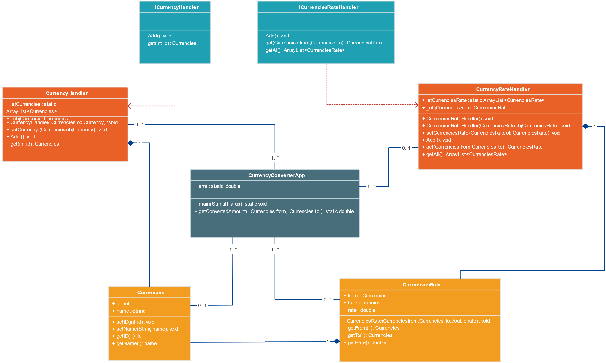
ARCHITECTURE AND DESIGN

Slide 15
IMPLEMENTATION
SQL:-
Currency converter
Database details
------------------
Database name:converter
table name: login
query:
----------------------
create database converter;
use database converter
create table login
-> (user int auto_increment key not null,
-> username varchar(100),
-> password varchar(100)
-> );
insert into converter values(1,'Anjali','Anjali@123');

Slide 16
Python:-
# Import module
from tkinter import *
from tkinter import messagebox
import mysql.connector
# Create object
root = Tk()
# Adjust size
root.geometry("1280x800")
root.title('Login')
# Add image file
bg = PhotoImage(file = "D:\Amritha\currency\img.png")
def login():
username = username_entry.get()
password = password_entry.get()
if username=='' or password=='':
messagebox.showerror(title="Error", message="Invalid login.")
else:

Slide 17
try:
mydb=mysql.connector.connect(host='localhost',user='root',password='password',database='converter')
mycursor =mydb.cursor()
print("connected")
except:
messagebox.showerror("connection","Database connection not established")
return
command="use converter"
mycursor.execute(command)
command="select * from login where username=%s and password=%s"
mycursor.execute(command,(username,password))
myresult= mycursor.fetchone()
print(myresult)
if myresult==None:
messagebox.showinfo("invalid","Invalid username and password")
else:
messagebox.showinfo("Login","Successfully Login!!")
root.destroy()
import currency
# Create Canvas
canvas1 = Canvas( root, width = 1000,height = 400)
canvas1.pack(fill = "both", expand = True)
# Display image
canvas1.create_image( 0, 0, image = bg,anchor = "nw")
# Add Text
canvas1.create_text( 996, 220, text = "Login", font=("Times New Roman", 30))
canvas1.create_text( 930, 300, text = "Username", font=("Times New Roman", 20))
canvas1.create_text( 930, 400, text = "Password", font=("Times New Roman", 20))
#text bxes
username_entry = Entry(root, font=("Arial", 16))
password_entry = Entry(root, show="*", font=("Arial", 16))
# Create Buttons
button2 = Button( root, text = "Login" ,width = 10,height = 1, bg="#370466", fg="#FFFFFF", font=("Times New Roman", 16),command=login)

Slide 18
# Import module
import tkinter as tk
from tkinter import Tk, ttk
from tkinter import *
from tkinter import messagebox
from PIL import Image, ImageTk
import requests
import json
import mysql.connector
#colors
cor0 = "#FFFFFF" # white
cor1 = "#333333" # black
cor2 = "#EB5D51" # red
btn = "#250071" #purple
mainc = "#EEF0FD"
subc = "#EDD399"
# Create object
root = Tk()
# Adjust size
root.geometry("1280x800")
root.title('Converter')
# Add image file
bg = PhotoImage(file = "D:\Amritha\currency\img1.png")
def history():
root.destroy()
import cnvrt
def convert():
url = "https://currency-converter18.p.rapidapi.com/api/v1/convert"
currency_1 = combo1.get()
currency_2 = combo2.get()
amount = value.get()
querystring = {"from":currency_1,"to":currency_2,"amount":amount}

Slide 19
import mysql.connector
import tkinter as tk
from tkinter import * my_w = tk.Tk()
my_w.geometry("400x250")
my_w.title('history')
mydb=mysql.connector.connect(host='localhost',user='root',password='password',database='converter')
my_conn = mydb.cursor()
my_conn.execute("SELECT * FROM history limit 0,10")
e=Label(my_w,width=10,text='From',borderwidth=3, relief='ridge',anchor='w',bg='beige')
e.grid(row=0,column=0)
e=Label(my_w,width=10,text='To',borderwidth=3, relief='ridge',anchor='w',bg='beige')
e.grid(row=0,column=1)
e=Label(my_w,width=10,text='Amount',borderwidth=3, relief='ridge',anchor='w',bg='beige')
e.grid(row=0,column=2)
e=Label(my_w,width=10,text='Result',borderwidth=3, relief='ridge',anchor='w',bg='beige')
e.grid(row=0,column=3)
i=1
for student in my_conn:
for j in range(len(student)):
e=Label(my_w,width=10, text=student[j],borderwidth=3,relief='ridge', anchor="w")
e.grid(row=i, column=j)
i=i+1

Slide 20
results

Slide 21
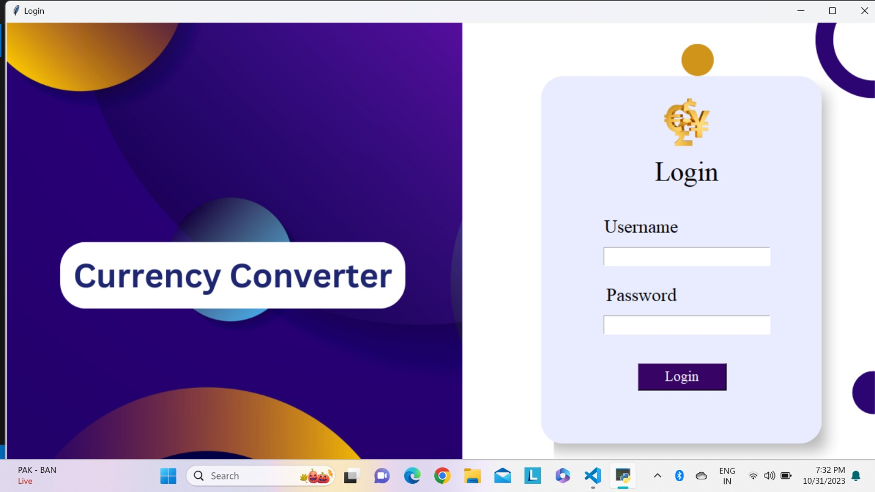
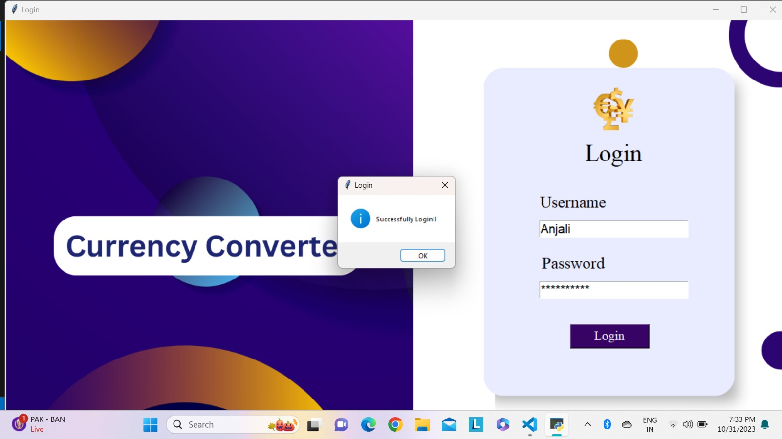
ddddd
LOGIN PAGE
SUCCESSFUL LOGIN PAGE

Slide 22
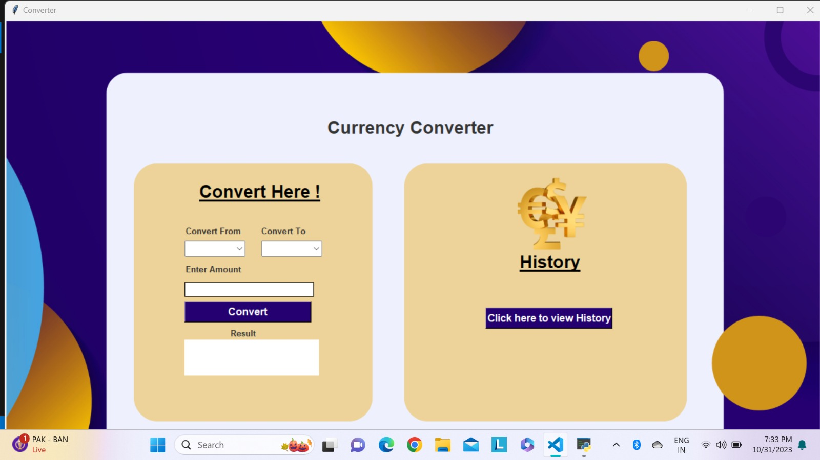
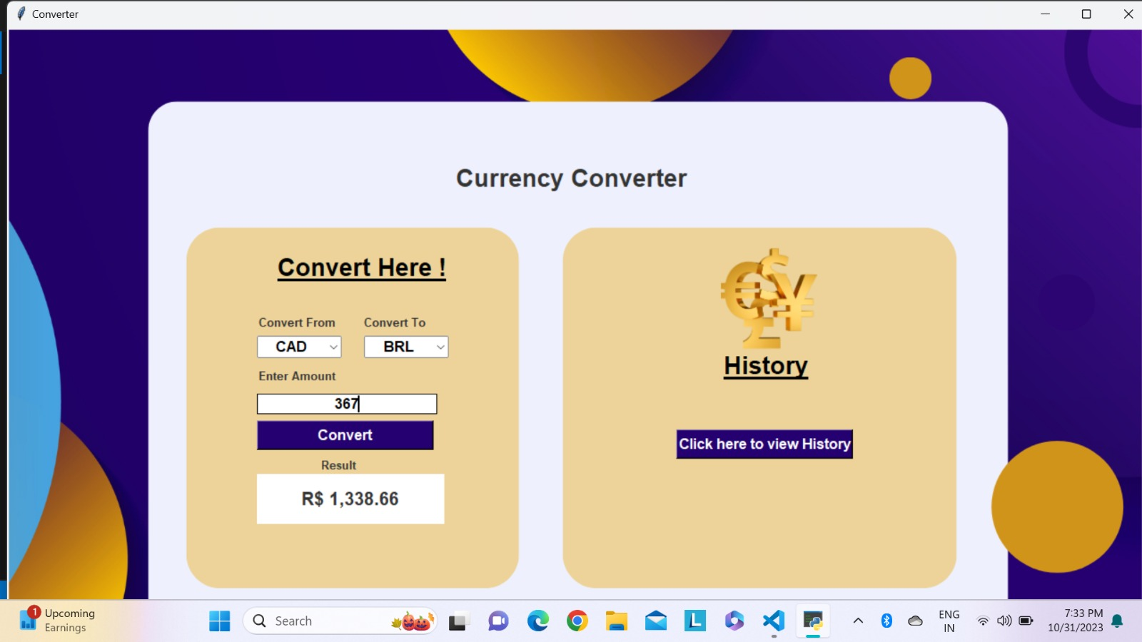
CURRENCY CONVERTER PAGE
CURRENCY TO BE CONVERTED

Slide 23
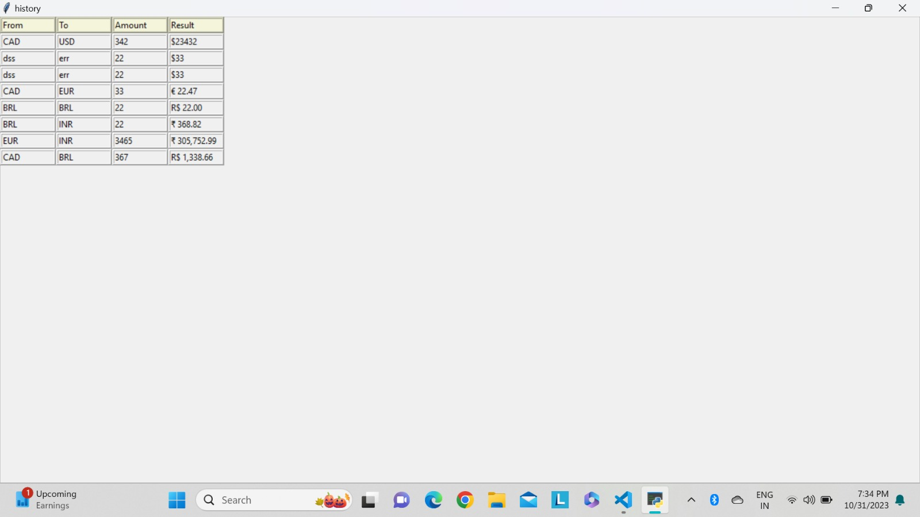
CURRENCY CONVERTED!

Slide 24
CONCLUSION:-
In conclusion, a thorough review of the literature and an awareness of user demands in the global financial scene served as the inspiration for the Currency Converter Application, a deliberate attempt to overcome the inherent difficulties in currency conversion. The project seeks to deliver a dependable, effective, and user-friendly solution for offline and real-time currency conversions by combining best practices from previous research. The need for a flexible tool that not only satisfies present needs but also develops with the help of the developer community is what inspired the creation of the Currency Converter Application. The Currency Converter Application hopes to be a useful tool for people and companies negotiating the challenges of global finance through its open-source design and commitment to accepted standards.

Slide 25
REFERENCES:-
https://www.geeksforgeeks.org
https://www.w3schools.in
https://wiingy.com
https://www.learningmilestone.com
https://medium.com

Slide 26
☺ THANK YOU ☺
PARVATHY V NAIR
(RA2211003010295)
ANYESHA BISWAS
(RA2211003010298)
ACHANTA BHAVYA SREE
(RA2211003010316)

